Slide 1
SECURITY CHALLENGES IN SMART CONTRACTS
Lucas pelloni
Ile cepilov
Notes:
ILE
Hi every one.
Today we are going to tell you about Smart Contracts and their security challanges.

Slide 2
Content
Blockchain
What is a Blockchain?
How does it work?
Smart Contracts Introduction
What is a Smart Contract?
Scenario Example
Traditional Contracts vs. Smart Contracts
Possible applications
Ethereum, Blockchain-based Platform
Notes:
ILE

Slide 3
Content
Security Challenges in Smart Contract
Dao Attack
King of the Ether Throne Attack
Multi-Player Game Attack
Rubixi Attack
Govern-Mental Attack
Questions
Discussion
Notes:
ILE

Slide 4
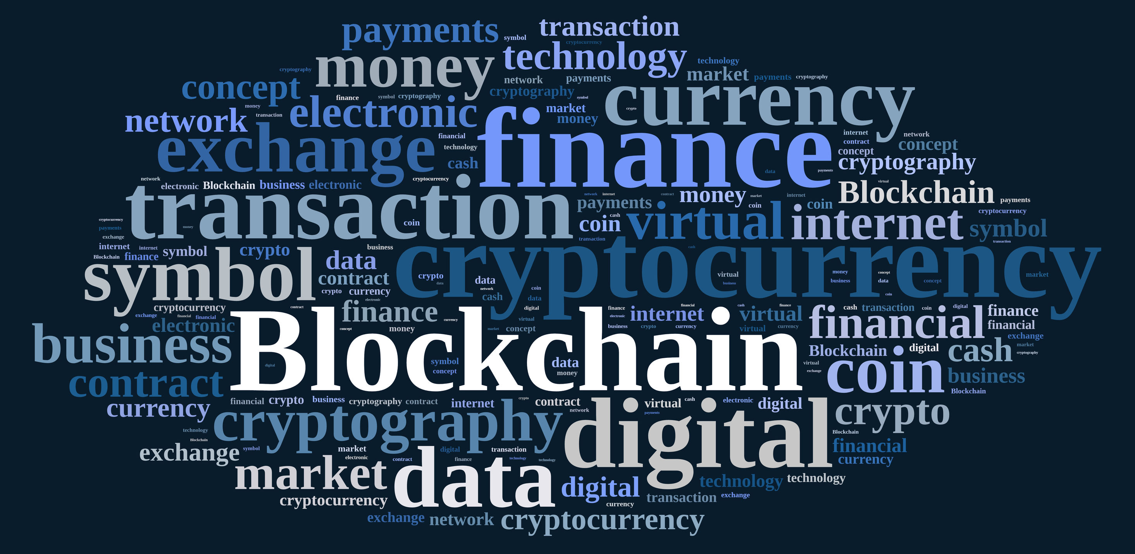
2.1 What is a blockchain AND HOW DOES IT WORK?
Distributed Database
Public digital ledger
Source of Trust
Notes:
ILE
DISTRIBUTED DB
You can see BLOCKCHAIN as an open distributed database which keeps track of every transaction involving values and maintained by the nodes of a P2P network (miners) (Money, goods, property word or even votes)
Thanks to the decentralized database, there is no longer the need of a thirty part trust organisation
PUBLIC LEDGER
Every transaction will be recorded on a public and distributed ledger
YOU CAN SEE THIS DATABSE AS A PL accessible to everybody
SOURCE OF TRUST
Blockchain will become a global decentralised source of trust
Because nowadays, , most people use a trusted middleman such as a bank to make a transaction which makes it easier to attack, whereas the blockchain allows consumers and supplier to connect directly
Everything that is centralized makes it easy to attack because it offers a single point of failure.
(e.g. Firewall of a website).
Application built with Bloch chain technlogy do not require users to trust the developers with personal information or funds.

Slide 5





2.2 How does blockchain work?
Notes:
_LUCAS
So to make it easier to understand, we will give you an example.
So let's say alice wants to buy a product from bob’s store.
Recently bob's store introduced crypovalues (for example bitcoins) as a payment method.
Alice has some bitcoins to spend and she wants to buy a product using them.
The transaction can be represented online as a ‘block’

Slide 6





2.2 How does blockchain work?
Notes:
The block (resp. the transaction) is broadcast across the entire network.
In order to complete the transaction, the miners (the nodes) have to validate it.

Slide 7


2.2 How does blockchain work?
Notes:
Once validated, the block is added to the blockchain, which records the entire NON-reversible history of transaction in a public ledger
after the validation process the money moves from Alice to Bob
--------------------------------------------------------------------------
???? tbd
APPLICATION BLOCKCHAIN
One of the most famous blockchain application is the transfer of bitcoins used for online trades.
2. Cloud storage distributed systems across the network (like StroJ) where each file is shredded and encrypted and distributed across the network)

Slide 8
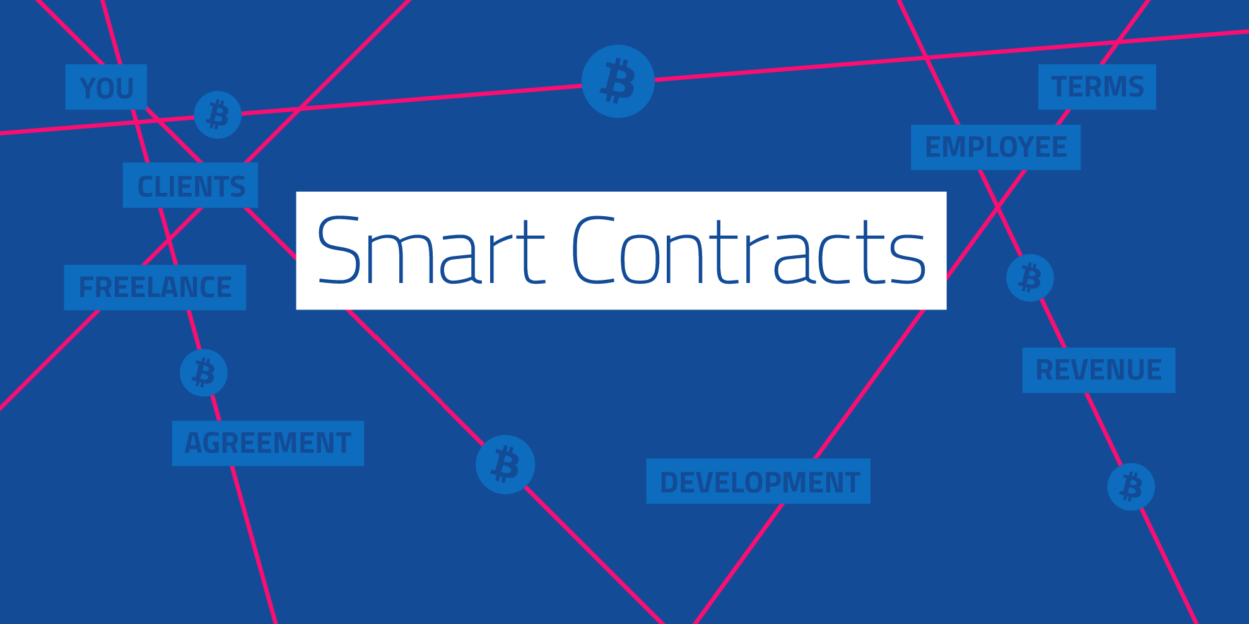
Notes:
Think of it as wills and contract that execute themselves

Slide 9
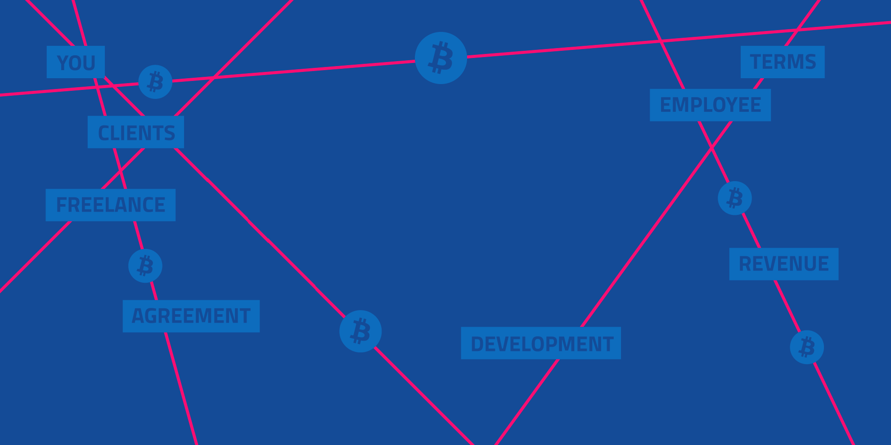
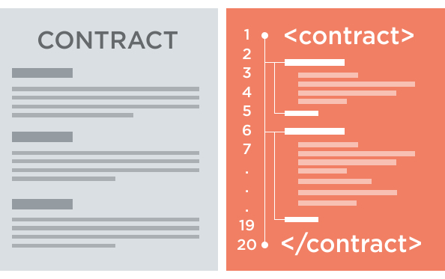
3.1 What is a smart contracT?
A smart contract is a piece of software that defines the rules of an agreement
It automatically verifies itself and executes the terms contained inside it
Stored on the Blockchain
Notes:
A SC is a piece of software or a program that stores rules for negotiating the terms of a contract, it automatically verifies the contract and then executes the agreed terms
Encrypted and Stored on the blockchain, which means that an external trusted authority is not needed and if any party fails the system continues to functions with no loss of data or integrity
To append a new block of data (the code for the execution of a SC) to the blockchain, the miners have to validate the exectuion of the SC

Slide 10
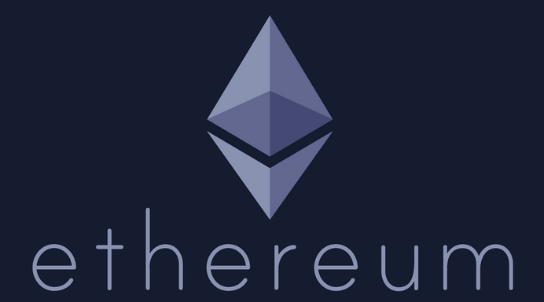
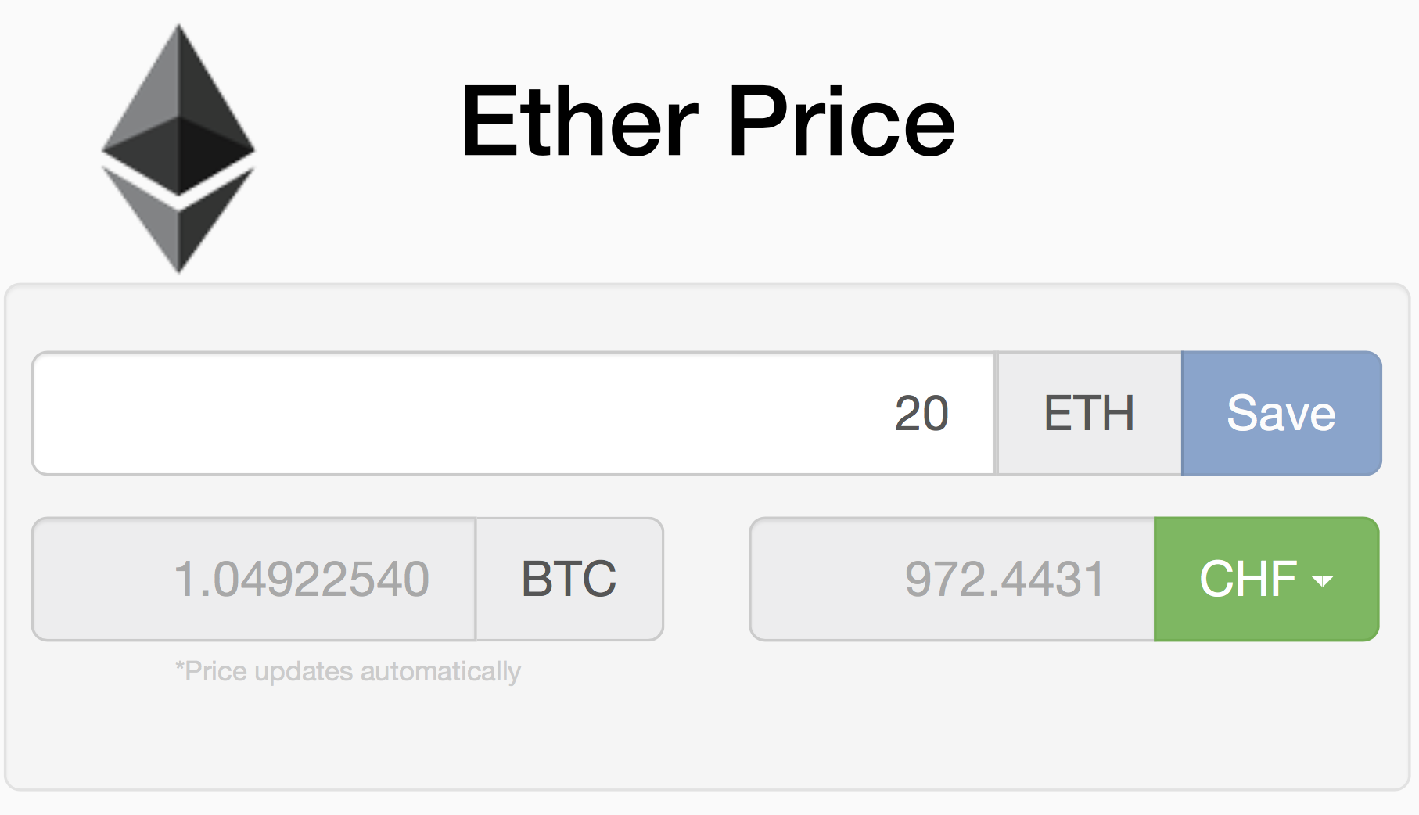
3.2 Ethereum, Blockchain-based Platform
Decentralized platform that runs smart contracts
Custom built Blockchain
Ether
Solidity (high) & EVM (low)
Notes:
Ethereum is a decentralized platform that runs smart contracts exactly as programmed wihout any possibility of downtime, fraud or third party interference
The SCs run on a custom built blockchain, which is not the same used for BITCOINS transactions
The cryptovalue used in Ethereum is not Bitcoins but it is ETHER,which is used as a payment method for executing contracts
-->IMMAGINEEEEEEEEE
The code of an Ethereum contract is written in Solidity, which is a high level language that looks like JavaScript. It is compiled on the Ethereum virtual machine.

Slide 11
3.3 SMART CONTRACT’S properties IN ETHEREUM
Contract address
Balance
Fallback function()
Variable msg (amount, data)
Gas system
Gas limit
Gas price
Notes:
And now let's have a look at the main properities of a SC in ethereum.
It is identified by a contract address;
It has a balance which holds the amount of virtual coins (ether)
It always has a Fallbackfunction which is obviously a function but with no parameters and no name:
Any transaction invoking a contract will execute the fallback function by default.
The informations of the sender, the amount of Ether sent to the contract and the included data of the transaction are stored in a variable called msg.
Then there is the Gas system , which is there
To ensure fair compensation for the computational effort.
When a user sends a transaction to invoke a contract, he has to specify how much gas he is willing to provide for the execution (called gasLimit) as well as the price for each gas unit (called gasPrice) .
--------
Example:
You can imagine the GasLimits: as the amount in liter of gasoline (10Liters)
GasPrice: price for each liter of gasoline
→If the amount is too much or the price for each liter is too high, the execution is terminated with an exception → state is reverted as it nothing happened BUT the gasLImit has to be paid as a counter measure against resource-exhaustion attacks
On Ethereum, miners are free to ignore transactions whose gas price limit is too low.

Slide 12
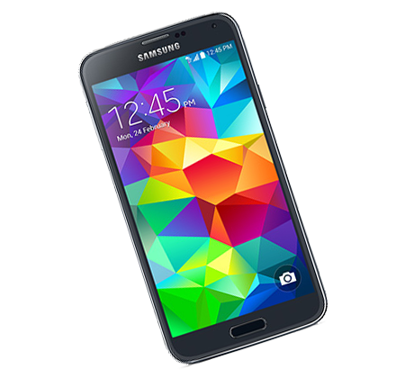
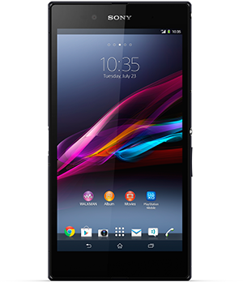
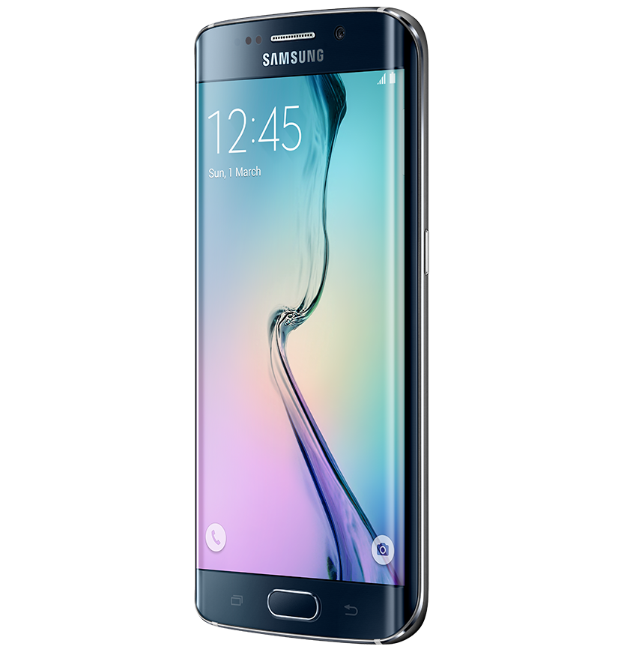
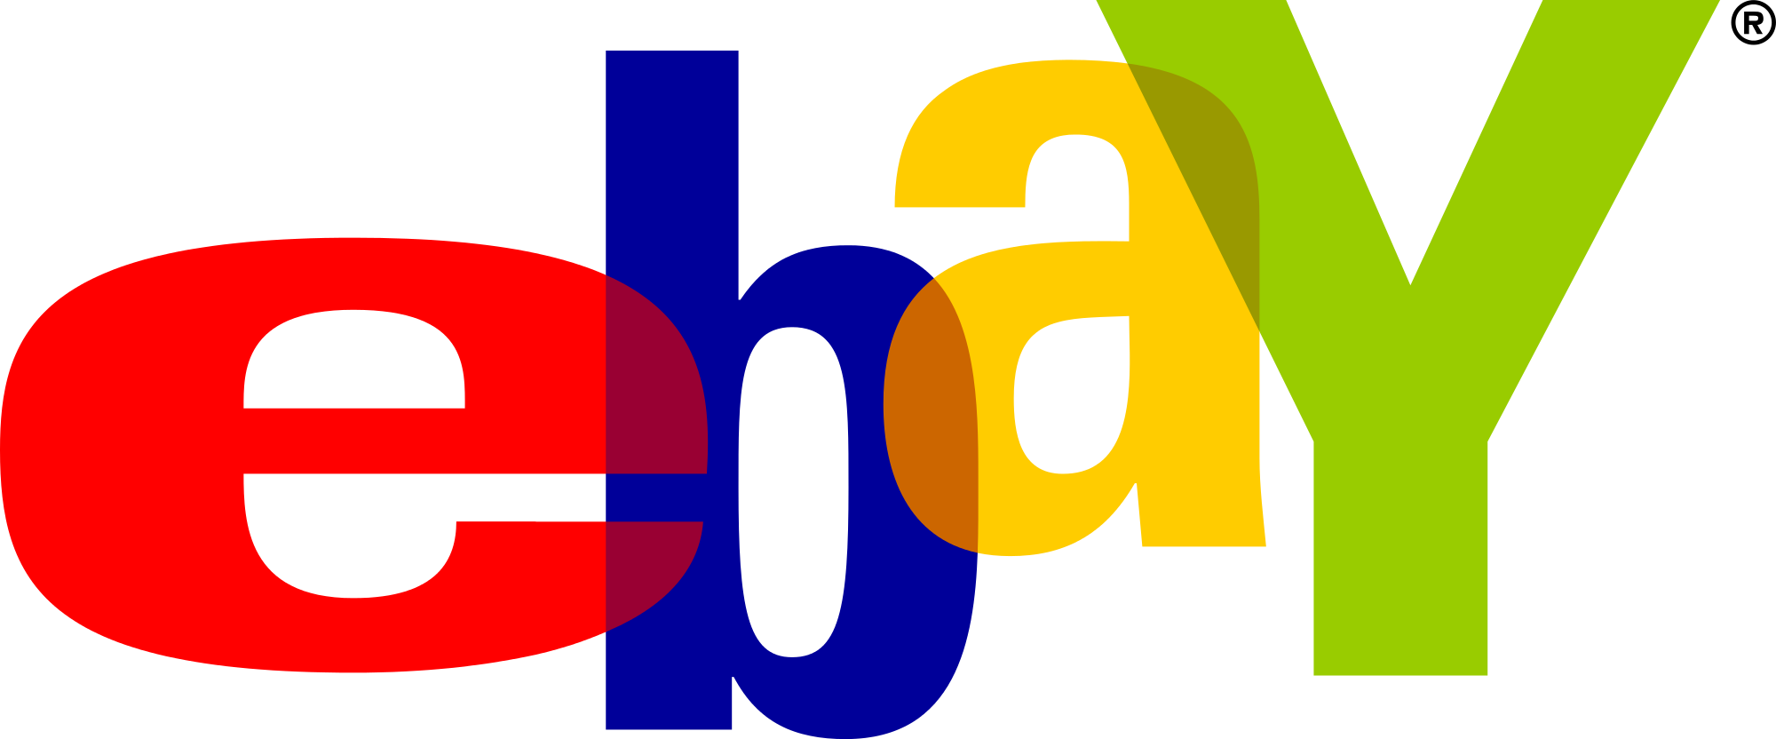
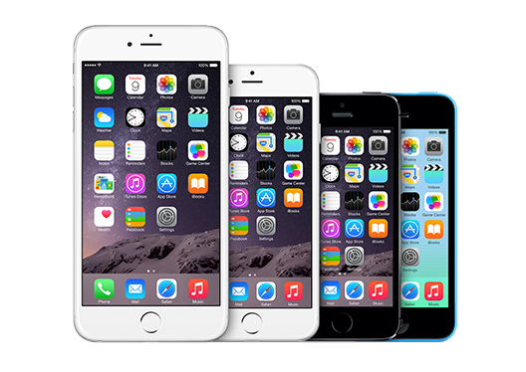
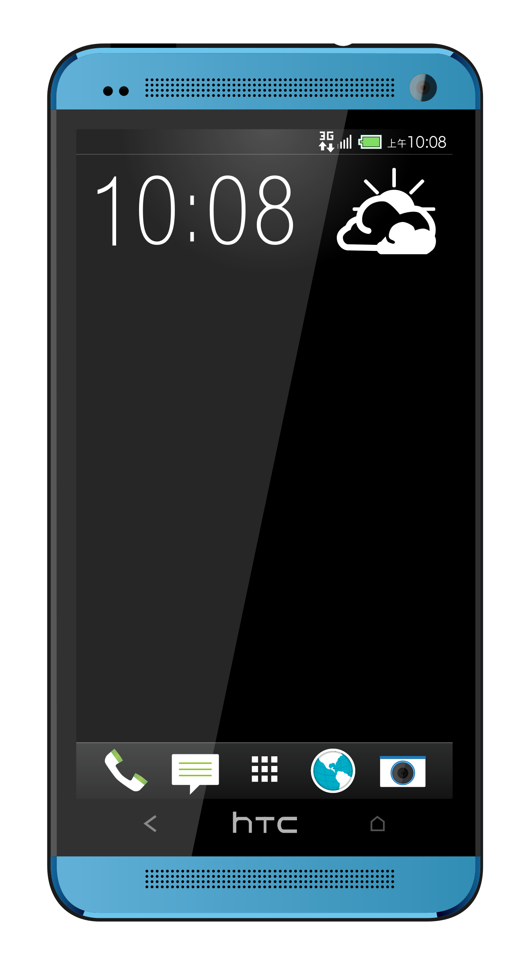
3.4 Scenario Example
Notes:
Let's consider another scenario example.
A online payment without involving a smart contract.
Like before
1. Alice wants to buy a SmartPhone on Ebay.
She is willing to pay a certain amount of money for it.
This time we are not going to talk about bitcoins, instead we are going to focus on the payment process.
Alice chooses a smart phone (a samsung:))

Slide 13
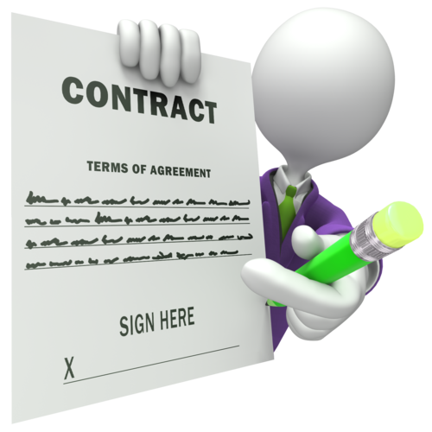
3.4 Scenario Example
Notes:
For buying the smart phone, alice wants to make sure that she would get the product she is paying for. Therefore, she stipulates a TRADITIONAL contract with Bob, an Ebay employee who works in the legal area.
On the tradictional contract there are the following agreements:
The Phone will be shipped to Alice only once the money transaction has been confirmed.
The middleman Bob, is in charge of checking whether the payment has really been made.
If not, he waits 1-2 days and then he checks the payment again.

Slide 14

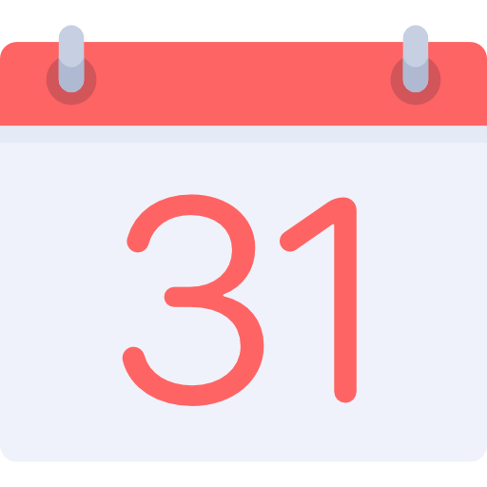

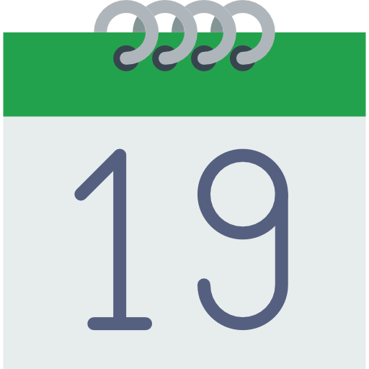


3.4 Scenario Example
I will check
it again in
2 days..
Where is
my phone?
Notes:
A better explanation of the contract terms
Alice pays for her Smartphone on a certain day (the end of the month)
Bob, doesn’t know when Alice actually paid for her Smartphone. Therefore he checks the payment once in a while.
The first time that bob checks the payment, the money is not arrived yet (even though alice already paid for her product)
Bob not seeing (SIIIIIIIING) the money and according to the contract terms, waits another two days for checking the payment again
In the meantime, alice is getting angrier (ENGRIER)
The money transfer is finally completed but bob, who had just checked, waits another two days
After two days bob checks the payment again, and he notes that the money has been successfully transfered
After that, the product is ready to be shipped
In total, alice waitet almoust three weeks to get her smartphone
As you can see, Alice is not happy with this kind of deal. A traditional contract needs always a middleman, who checks and executes the agreed terms defined in the contract.
This process implies (IMPLAIS) always a delay between seller and buyers and implies also some costs for the company (the middleman has to be paid for his work).
A lawyer (LOYER) might be necessary if some party doesn’t comply with the contract.

Slide 15



3.4 Scenario Example
I could use
a Smart Contract!
Notes:
Alice got an idea! She could use a smart contract to make the process faster and better.
Let’s suppose that Ebay works together with a company which provides some services for Smart Contracts (e.g. Ethereum).
Alice wants to try this new service and stipulates a new SM with Ebay.

Slide 16
3.4 Scenario Example
Notes:
As soon as Alice makes the payment, the SC is triggered and when the payment is confirmed, Ebay will be noticed (NOTISD) by the SC and can immediately send the smart phone.
As you can see: the process is istanteneous and there is NO need of a middleman

Slide 17
3.4 Scenario Example
Notes:
Just follow alice and choose a smart contract!
if you don't want to get angry

Slide 18
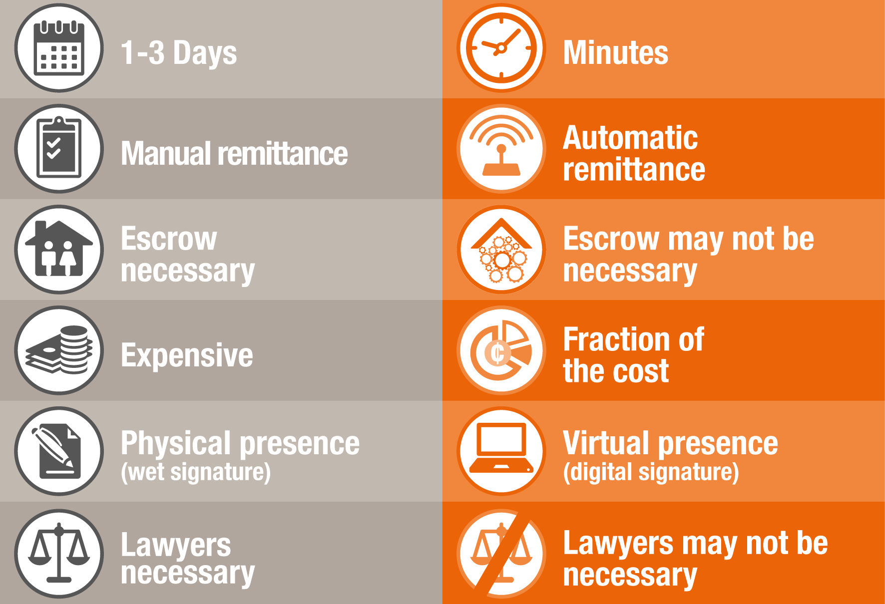
3.5 Traditional ContractS vs. Smart Contracts
TRADITIONAL
SMART
Notes:
http://www.pwc.com/us/en/technology-forecast/blockchain/digital-business.html
According to our example of Alice and Bob the following table shows the main differences between traditional and smart contracts:
The execution of a smart contract doensn’t need a middleman, which mean that can be executed faster
Manual remittance: Ebay is immediately notified
A Smart Contract is for sure cheaper than a traditional one. You don’t have to pay for a middleman who checks the agreements, you have only to pay the ”code”.
A Smart Contract cannot get lost and its always available in chronological order on the blockchain for future access
Like said before, there is no need of a middleman (lawyer)
A Smart contract on a blockchain is like a single large secure Computer System BUT without the risks, costs and trust issues of a centralised model

Slide 19
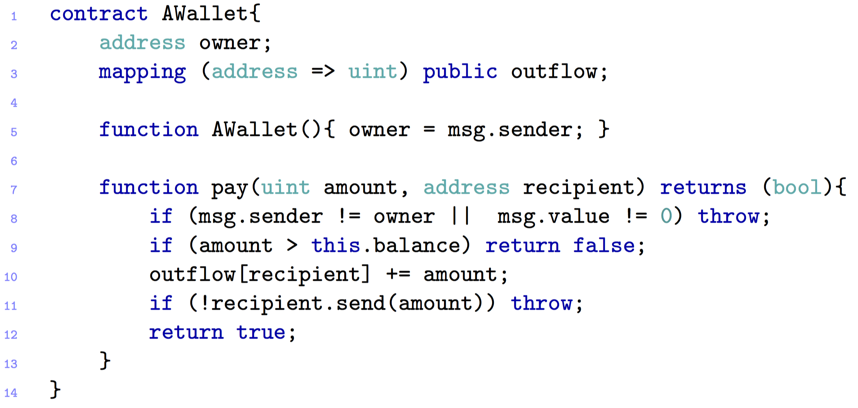
3.6 A simple WALLET CONTRACT
Notes:
This contract is written in Solidity language,
What goes INTO A SMART CONTRACT?
EXPLAIN THE CODE:
$This snippet implements a personal wallet associated to an owner.
Line 5: Constructor, where the wallet gets associated to its owner
Line 7: Pay function which takes as parameters an amount of cryptovalue and the address of the recipient
Line 8: Exception that gets thrown if the caller is not the owner (the owner is the only one that can logically send his money) or if some ether (cryptovalue used on the Etheruem platform, analogous as Bitcoins) is attached to the invocation and transferred to the contract (se vuoi trasferire degli ether a te stesso mentre evochi questa funzione)
Line 9: the Call returns false if there is not enough amount on the wallet
Line 10: The outflow registry (blockchain) gets updated before the ether is transferred to the recipient.
Line 11: If the recipient is a contract return false

Slide 20
3.7 Possible Applications
Financial services
Coupon payments
Loans (e.g. Leasing)
Life sciences
Electronic medical records
Cross-Industry
Voting
Notes:
THIS SLIDE TAKES ONLY FEW SECONDS!!!!! ☺ ☺ ☺
Coupon payments: Automatically calculates and pays period coupon payments (for bonds)
Leasings: could be stored as a SC in the blockchain, togheter with some ownership information. If the borrower misses a payment, the SC should automatically revoke the digital keys that grant his access to the collateral. (esempio automobile hardware motore)
Voting: validates voter criteria, logs vote to the blockchain

Slide 21

SMART CONTRACT
ATTACKS
AND....

Slide 22

SECURITY CHALLENGES
IN SMART CONTRACT

Slide 23
4.2 MOST FAMOUS ATTACKS – The DAO ATTACK 1
Crowd-funding platform
Attacker managed to put over $60 M

Slide 24
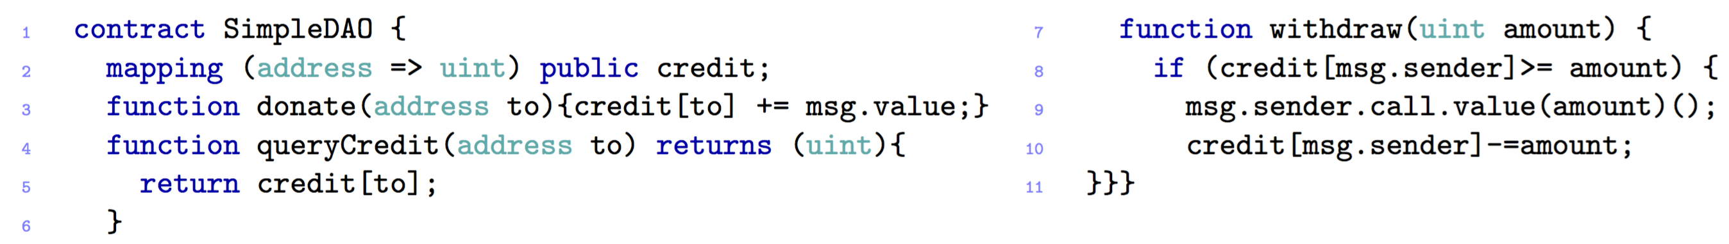
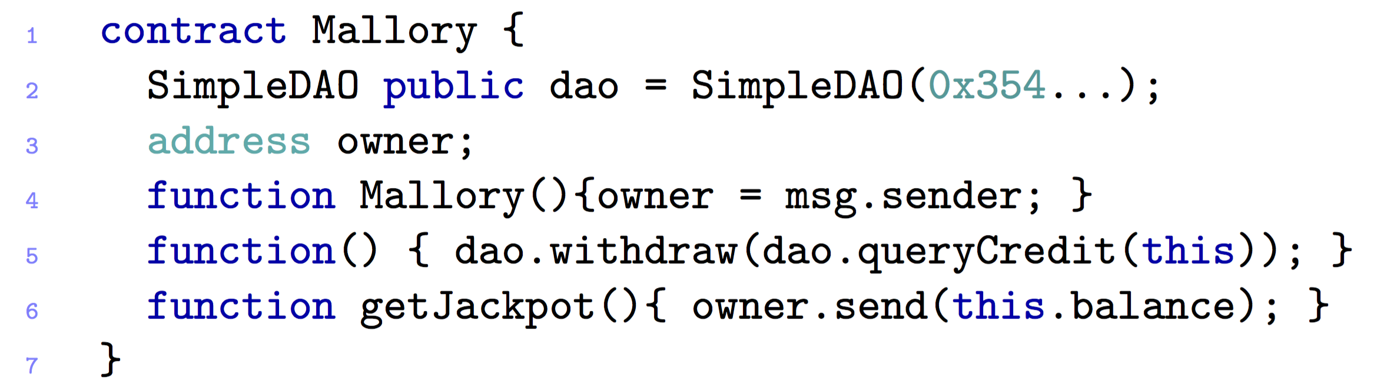
4.2 MOST FAMOUS ATTACKS – The DAO ATTACK – #1
Notes:
Consider this SimpleDAO Contract
The Attack which we want to present you allows the hacker to steal all the ether from the SimpleDAO:
It works as follows:
Publish a Mallory Contract (like this one)
The Hacker donates some ether for Mallory and invokes the Mallory Fallback (Line 5.)
A Fallback is just a function without any name or parameter which will called by default if some ether is sent to the contract without providing any data
The Fallback inkoves the function withdraw of the SIMPLE DAO CONTRACT which transfers the ether to Mallory
The Function call inkoves the fallback of Mallory again (msg.sender.call.value(amount))
The fallback invokes again the withdraw and so on
NOTE: LINE 10 will never be updated until:
The gas is exhausted (gas = is a fee paid to the miners proportinal to their power computation)
Call Stack is full
Balance of DAO becomes 0

Slide 25
4.2 MOST FAMOUS ATTACKS – The DAO ATTACK 1 – POSSIBLE SOLUTIONS
There are only ways to suppress the attack
Soft-Fork
Intention: Freeze attacker’s transaction
Miner Majority must accept it
Hard-Fork
Return all the Ether taken from the DAO to a refund Smart Contract
Only one function: “withdraw”
Approved by the community on the 19th July
Completed on the 20th July
Notes:
https://www.cryptocompare.com/coins/guides/the-dao-the-hack-the-soft-fork-and-the-hard-fork/
New Challenge:
Soft-Fork
The blocks that contain a transaction that helps the attacker move the Dark DAO funds will be ignored! -> Introduction of DOS attack
Hard-Fork
A more conclusive solution was then put up for vote, the Hard-fork. This hard-fork had the sole function of returning all the Ether taken from the DAO to a refund smart contract. The new contract would have only one function: withdraw. The DAO token holders can request to be sent 1 ETH for every 100 DAO. The investors that had paid more than 1 ETH for 100 DAO could request the difference from the original address.

Slide 26
4.2 MOST FAMOUS ATTACKS – KING OF THE ETHER THRONE
Game’s goal: become the “King of Ether”
You have to pay the current king and a small fee to the contract
Prize increases each time

Slide 27
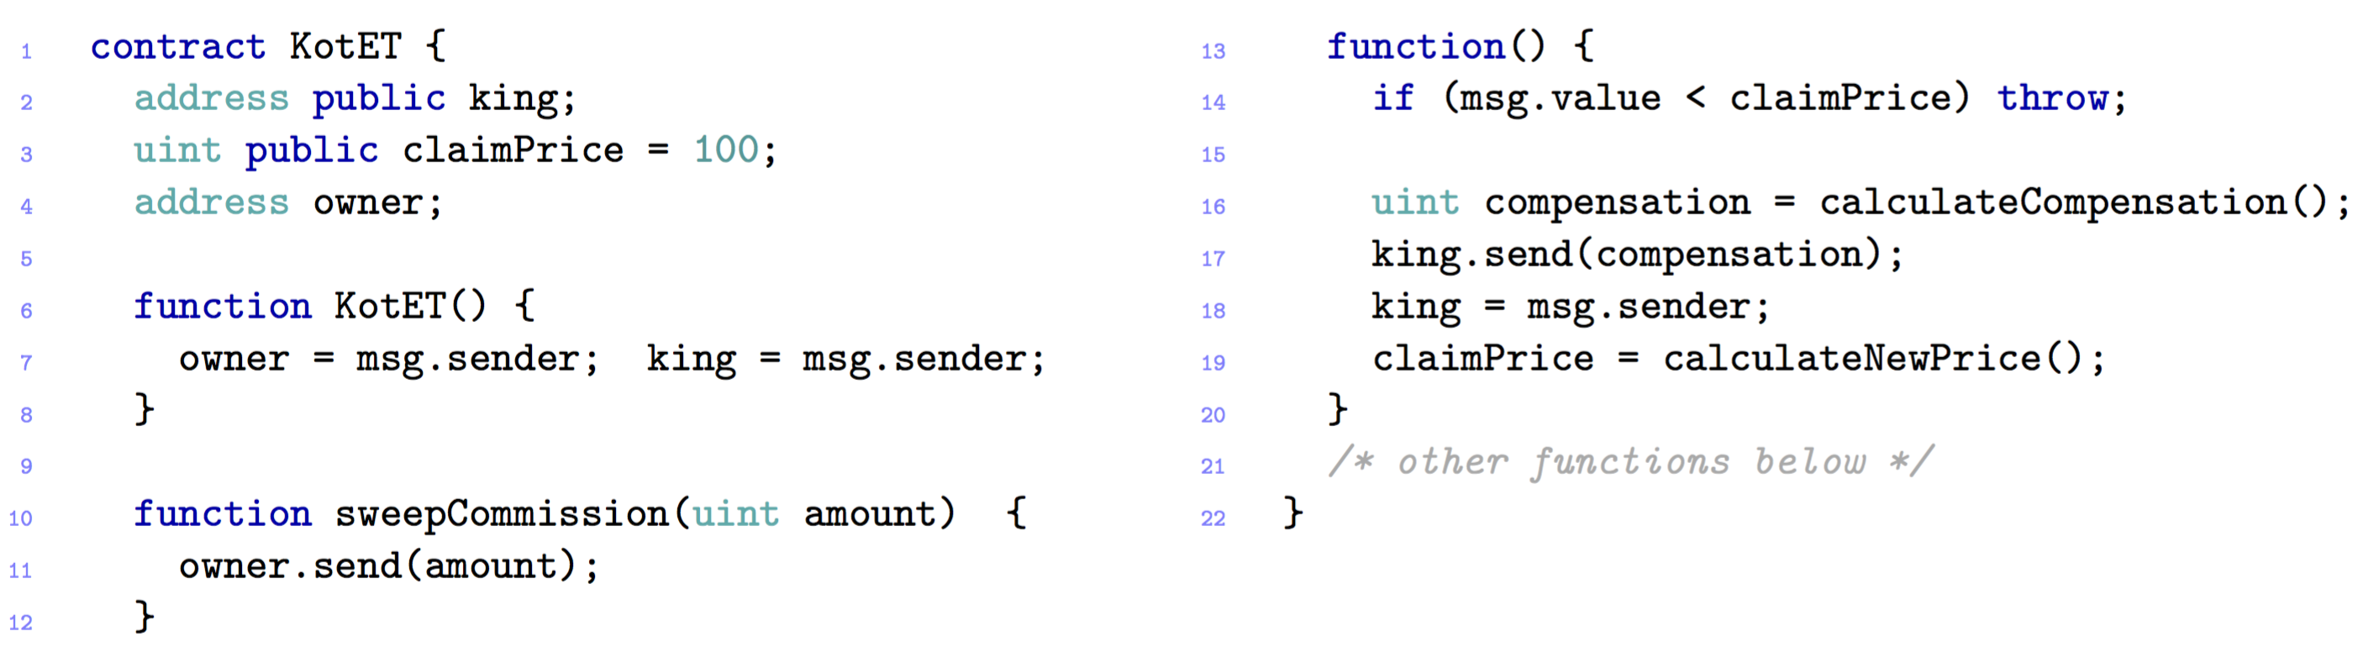
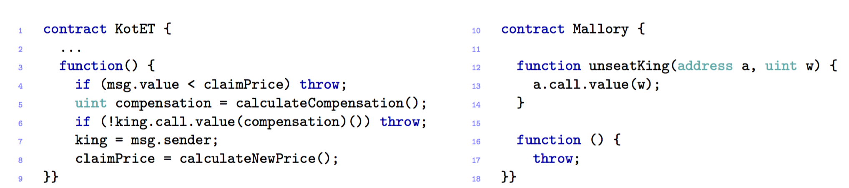
4.2 MOST FAMOUS ATTACKS – KING OF THE ETHER THRONE
Notes:
A Player sends some Ether to the contract
The function fallback is invoked
The fallback checks if the sent value is enough to buy the title (if not it throws an exception, which means that the the transfer is reverted)
If the amoCompensation is sent to the old kingThe new king is setted
The Difference between msg.value and the compensation is kept (KEPT) by the contract
The Owner of this contract can withdraw the ether accumulated (via sweepCommission)
unt is enough (INAF) the player is accepted as the new king
There could be a problem with this contract:
There is no checking in the return code of the function SEND -> this may result in stealing ether.
Indeed, since send is equipped with a few gas, the send at line 17 will fail if the king’s address is that of a contract with an expensive fallback
Line 17:
Se la chiamata king.send porta con se TROPPO POCO gas e il ricevente ha un fallback costoso (quindi il gas non è sufficiente per far partier la transazione) la compensazione rimane al contratto.
Questo principlamente dovuto dal fatto che non viene controllato il RETURN di king.send(compensation).
----------------------------
SECOND ATTACK
Consider an attacker Mallory, whose fallback just throws an exception. The hacker calls unseatKing with the right amount of ether, so that Mallory becomes the new king.
At this point, nobody else can get her crown, since every time KotET tries to send the compensation to Mallory, her fallback throws an exception, preventing the coronation to succeed.
Chiami unseatKing e diventi KING
Qualcun’altro vuole diventare king -> quindi viene provata di mandare la compensation a Mallory -> entra in gioco il Fallback che viene chiamato e -> throw -> nessuno sarà mai coronato

Slide 28
4.2 MOST FAMOUS ATTACKS – King Of the ether – POSSIBLE SOLUTIONS
Failed compensation sends
Include more gas with each payment
Exception disorder
Handle exceptions in a uniformly way
Notes:
https://www.kingoftheether.com/contract-safety-checklist.html
An earlier version of King of the Ether suffered from failure to send compensation payments to wallet contracts created by older versions of the Mist Ethereum Wallet.
We have mitigated against this risk by:
POSSIBLE SOLUTIONS TO CHECK THE KING.SEND
Including a reasonable amount of gas with each payment sent.
If sending a compensation payment still fails, we detect this and ring-fence the funds for the recipient to withdraw.
Running several functional tests for this scenario - see e.g. "Compensation payment failure detected when sending to a very expensive wallet contract" and "Successfully resend failed compensation payment" in our on-chain test report.
------------------------------------------
All code and data on the blockchain is visible by anyone, even if not marked as "public" in Solidity. Contracts that attempt to rely on keeping keys or behaviour secret are in for a surpsise.
We have mitigated against this risk by:
Ensuring our contracts do not rely on any secret information.
------------------------------------------
It's quite hard to calculate the maximum amount of gas a contract can use - famously Governmental got stuck due to this. To make matters worse, the maximum gas limit on the network can vary over time based on transaction fees.
We have mitigated against this risk by:
Being careful not to loop over (or delete) arrays that can grow as a result of user input.
Limiting the length of user-supplied data such as monarch names.
Running automated functional tests for gas usage.
Performing "fuzz testing" by generating random method calls and applying them to both the real Solidity contract and a Javascript simulation of intended behaviour, then looking for differences.
Note that we inadvertently deployed our first contract versions to production using a slightly different version of the Solidity compiler than we tested with - this caused gas costs on the real contract to be slightly higher than expected.

Slide 29
4.2 MOST FAMOUS ATTACKS – Multi-player games
Game: odds and evens
Each player choose a number
Sum is even or odd
Notes:
Consider a contract which implements a simple “odds and evens” game between two players. Each player chooses a number: if the sum is even, the first player wins, otherwise the second one wins.

Slide 30
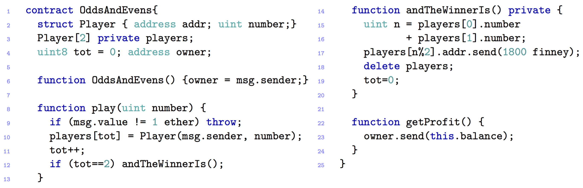
4.2 MOST FAMOUS ATTACKS – Multi-player games
Notes:
The contract works as follows:
The contract records the bets of two players in the field players (line2) Since this field is private, other contracts cannot directly read it.
To join the game each player has to play 2 ethers (line 8: function play). If the amount transferred is different, it is sent back to the player by throwing an exception (line 9).
Once the second player join the game -> the method andTheWinnerIs() (line 12) is called to send 1.8ether to the winner and
The remaining 0.2ether are kept by the contract, and they can be collected by the owner via getProfit().
---------------------- ATTACK
1. To do that, the adversary impersonates the second player, and waits that the first player makes his bet.
2. Now, although the field players is private, the adversary can infer the first player’s bet, by inspecting the blockchain transaction where he joined the game.
3. Then, the adversary can win the game by invoking play with a suitable bet19.

Slide 31
4.2 MOST FAMOUS ATTACKS – Multi Player Games– POSSIBLE SOLUTIONS
Keeping secrets
cryptographic techniques such as Timed-Commitments
The next player has to play his move within a set time period, otherwise he will get a penalty
Notes:
https://books.google.ch/books?id=7YGBCgAAQBAJ&pg=PA14&lpg=PA14&dq=timed+commitments+blockchain&source=bl&ots=jpTIFT8fFx&sig=x9lTOEaQH5K1aU8ipaj1f8dTSO8&hl=it&sa=X&ved=0ahUKEwiWraz8x-rSAhVG72MKHZZ6A7gQ6AEIJTAB#v=onepage&q=timed%20commitments%20blockchain&f=false

Slide 32
4.2 MOST FAMOUS ATTACKS – RUbixi
Ponzi Scheme, fraudulent investment program
Participants gain money from newcomers
Owner collects fees paid to the contract

Slide 33

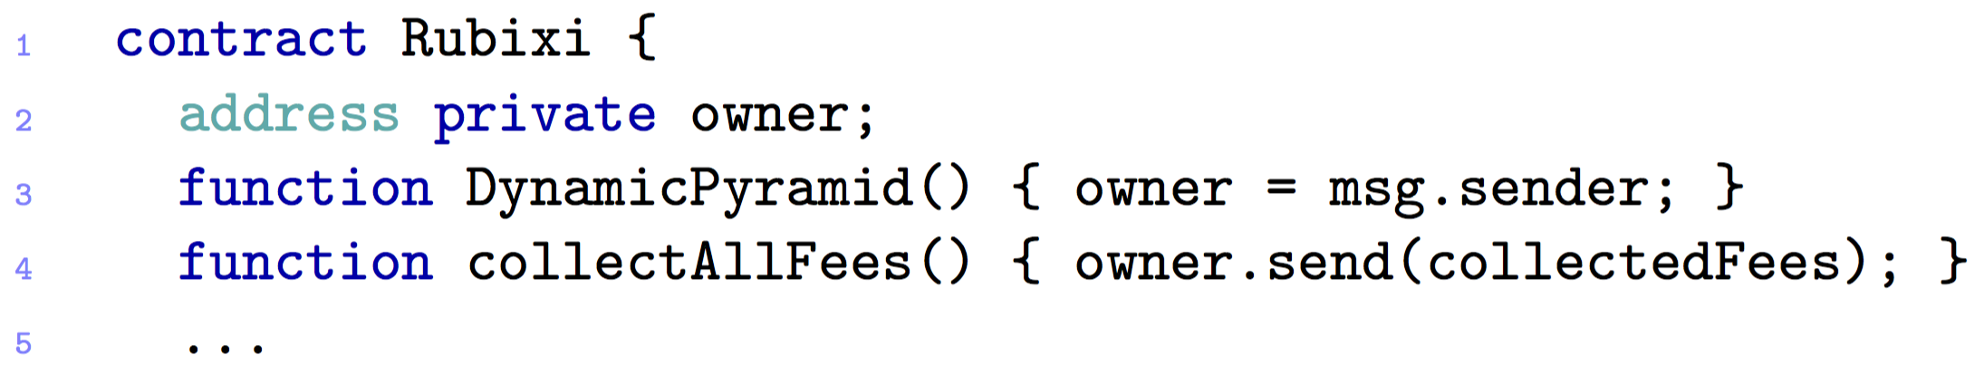
4.2 MOST FAMOUS ATTACKS – RUbixi
Financial
Notes:
At some point during the development of the contract, its name was changed from DynamicPyramid into Rubixi.
Programmers forgot to change the name of the constructor, which then became a function invokable by anyone
After this bug became public, users started to invoke DynamicPyramid in order to become the owner, and so to withdraw the fees.

Slide 34
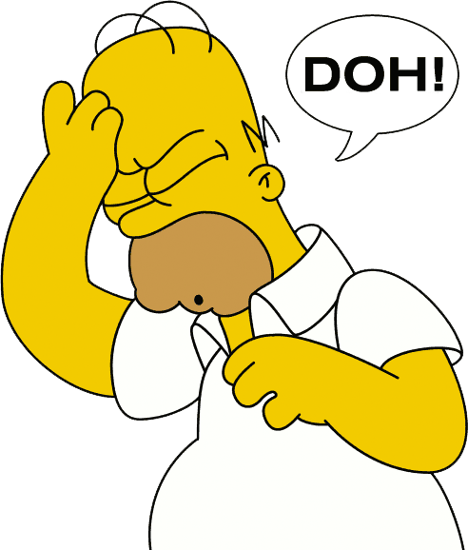
4.2 MOST FAMOUS ATTACKS – Rubixi– POSSIBLE SOLUTIONS
Change the constructor’s name ☺

Slide 35
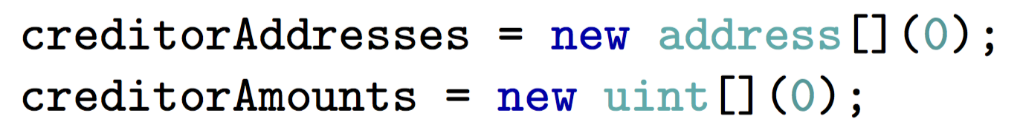
4.2 MOST FAMOUS ATTACKS – Govern-Mental
Ponzi Scheme
To join the scheme, participant must pay a fee
12 hours
Two arrays: list of participants and their credit
After 12 hours:
Notes:
To join the scheme, a participant must send a certain amount of ether to the contract.
If no one joins the scheme for 12 hours, the last participant gets all the ether in the contract (except for a fee kept by the owner)
When the 12 hours are expired, the last participant can claim the money, and the arrays are cleared as follows:

Slide 36
4.2 MOST FAMOUS ATTACKS – Govern-Mental
…
List grew to long!
Required gas for cleaning the arrays, exceeds the maximum allowed for a single transaction

Slide 37
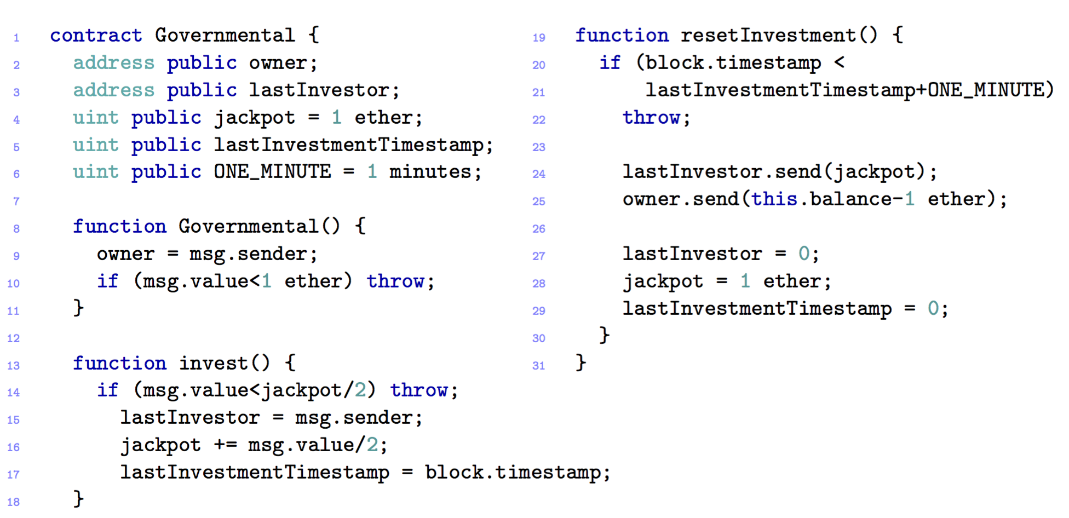
4.2 MOST FAMOUS ATTACKS – Govern-Mental
Notes:
To join the scheme, a player must invest at least half of the jackpot (line 14),
Anyone can invoke resetInvestment
To make this contract easier to understand the timestamp the interval is set to ONE_MINUTE instead of 12 Hours
Anyone can invoke resetInvestment(), which pays the jackpot (half of the invested total) to the winner (line 24), and sends the remaining ether to the contract owner.

Slide 38
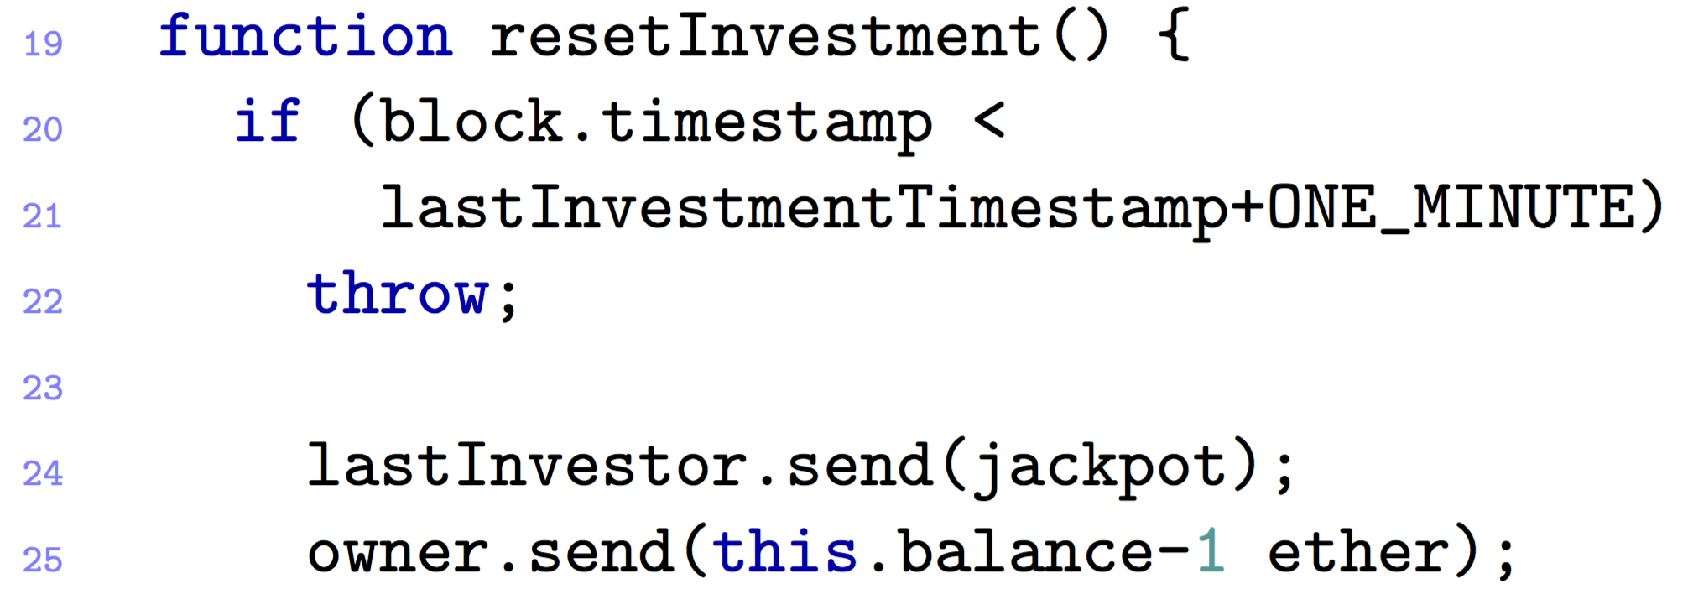

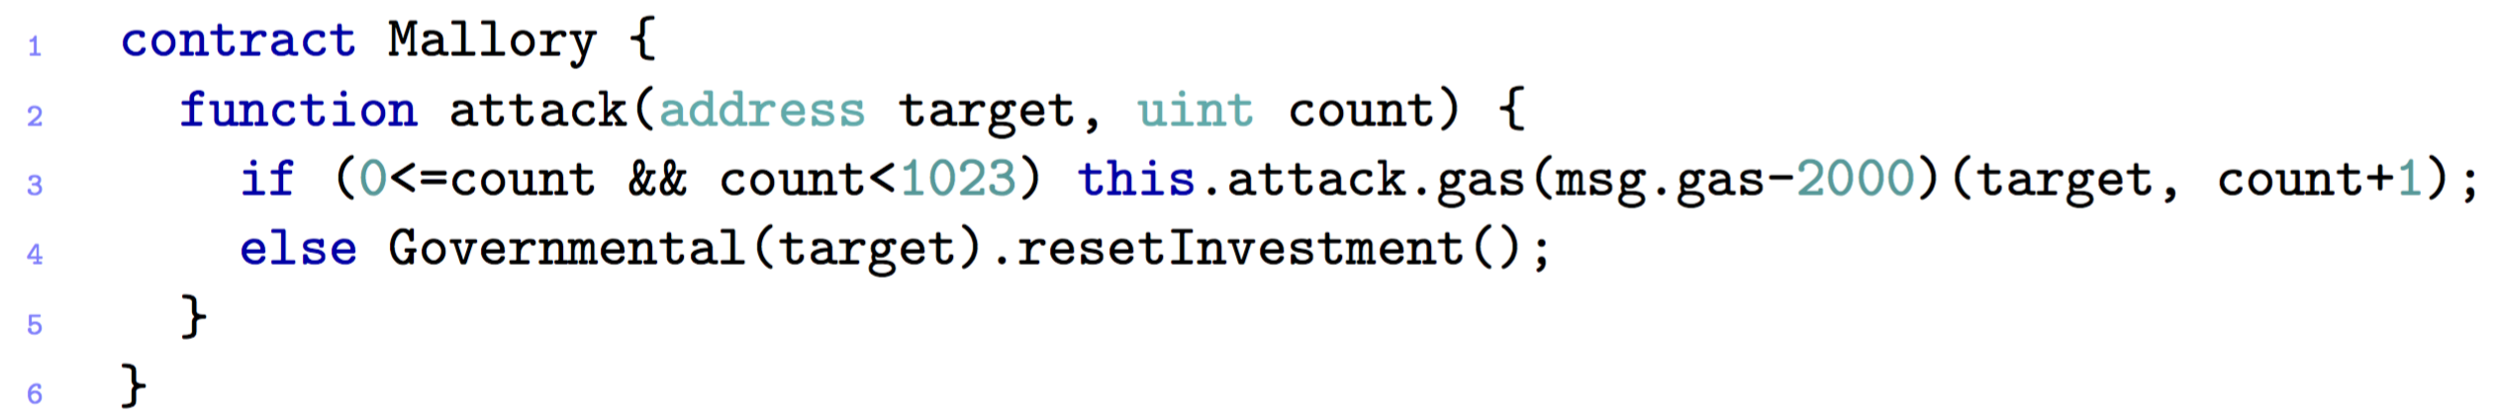
4.2 MOST FAMOUS ATTACKS – Govern-Mental
Notes:
Performed by the owner
His goal is not to pay the winner, so that the ether is kept by the contract,
To fulfil this goal, the owner has to make the send at line 24 fail.
First step is to publish a Mallory contract as follows:
Mallory starts invoking herself recursively (RECORSIVLY), making the stack grow
After 1022 function calls, the else statement is executed with resetInvestment().
The send at line 24 fails -> the stack limit is reached
Since GovernMental does not check the return code of send (LINE 24), the execution proceeds, resetting the contract state and starting another round
The balance of the contract increases every time this attack is run, because the legit winner is not paid. To collect the ether, the owner only needs to wait for another round to terminate correctly.

Slide 39
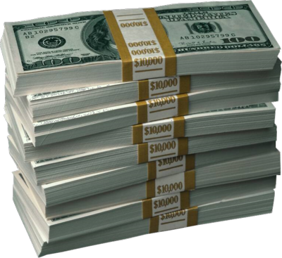
4.2 MOST FAMOUS ATTACKS – Govern-Mental– POSSIBLE SOLUTIONS
Increase cost of external function
Notes:
The vulnerability which has been used is “stack size limits”. This vulnerability has been fixed -> ….
From Solidity 0.4.2, the cost of external function calling has been increased so that it is impossible to fill the stack: any attempt will cause an out-of-gas exception. This makes the attack no longer possible.

Slide 40
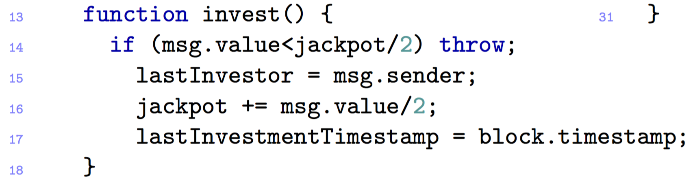
4.2 MOST FAMOUS ATTACKS – Govern-Mental - #2
Actual Jackpot: 10 ethers
Alice’s bet: 6 ethers
Actual Jackpot: 13 ethers
Bob’s bet: 8 ethers:
Actual Jackpot: 17 ethers
Attacker does not include in blocks the transactions in order to be the last player
Attacker’s bet: 10 ethers
Notes:
Attacker is a miner
Being a miner, she can choose not to include in blocks the transactions directed to GovernMental, except for her own, in order to be the last player in the round.
the attacker can reorder the transactions, such that her one will appear first

Slide 41
4.2 MOST FAMOUS ATTACKS – Govern-Mental– POSSIBLE SOLUTIONS
Exception disorders
Immutable bugs
Stack size limits

Slide 42
4.2 MOST FAMOUS ATTACKS – Govern-Mental - #3
The miner alters the timestamps
She manages to publish the new block with the delayed timestamp
She will be the last player and win the jackpot
Notes:
Also in this case the attacker is a miner impersonating a player.
Assume that the attacker manages to join the scheme. To be the last player in a round for a minute, she can play with the block timestamp.
More specifically, the attacker sets the timestamp of the new block so that it is at least one minute later the timestamp of the current block.
As discussed along with the “time constraints” vulnerability, there is a tolerance on the choice of the timestamp.
If the attacker manages to publish the new block with the delayed timestamp, she will be the last player in the round, and will win the jackpot.

Slide 43
4.2 MOST FAMOUS ATTACKS – Govern-Mental– POSSIBLE SOLUTIONS
Exception disorders
Immutable bugs
Stack size limits

Slide 44
5.1 OPEN Challenges in Smart Contract
No guarantee of transaction execution
E.g. KoTE
Turing-complete smart contracts are slow
Scaling is a moon-shot
Oracles break the trust model
Public Blockchain struggle to stay decentralized

Slide 45
5.1 EtherEum Challenges in Smart Contract
Improve Solidity
Documentation is divided across the network and not easily accessible
Trust is a must
Notes:
A significant part of them is related to Solidity, the high-level programming language supported by Ethereum. Many vulnerabilities seem to be caused by a misalignment between the semantics of Solidity and the intuition of programmers. The problem is that Solidity, whilst looking like a typed Javascript-like language (with exceptions and functions), implements some of these features in a peculiar way. At the same time, the language does not introduce constructs to deal with domain-specific aspects, like e.g. the fact that computation steps are recorded on a public blockchain, wherein they can be unpredictably reordered or delayed.
Another major cause of the proliferation of insecure smart contracts is that the documentation of known vulnerabilities is scattered through several sources, including the official documentation. A comprehensive, self-contained and updated sur- vey of vulnerabilities and attacks to Ethereum smart contracts is still lacking.
to append a new block of data to the blockchain, nodes must participate to a lottery, where the probability of winning is proportional to the computational power of the node. An incentive mechanism ensures that, even if a malicious node who wins the lottery tries to append a block with incorrect contract executions, this block will be eventually removed from the blockchain. Despite some criticism about the e↵ectiveness of the consensus protocol [37,44], recent theoretical studies establish its security whenever the honest nodes control the majority of the computational power of the network [39,52].

Slide 46

Questions?

Slide 47
Discussion – Smart contract Usability
Are Smart Contracts a really good solution ?
Can they completely replace traditional contracts?
Are there agreements that cannot be completely automatized, i.e. for which you cannot use a Smart Contract?
Does the delay imply always a problem?
Notes:
Gli Smart Contract sono una soluzione concreta o possono sostituire completamente I contratti tradizionali?
Ci sono agreements che non possono essere automatizati?
Qual’è il vero incentivo che muove I Miners (verifier) nela validiation di un contratto? Possono essere spinti solo dal fee che ricevono?
Dal momento che la invulnaribialità al 100% di un contratto non è garantita, preferireste affidarvi a contratti tradizionali (soggetti a interessi propri) o a un contratto soggetto ad attacchi hacker?
L’immediatezza di un contratto (e quindi senza l’intervento umano) rappresenta un vantaggio sempre? Esempio automobile -> metti che hai dei problemi in famiglia e la macchina si blocca subito alla prima rata non pagata senza neanche richiedere il perchè non è stata pagata la rata

Slide 48
Discussion – Smart contract Security
Would you be willing to rely on a Smart Contract?
If yes, in which cases would you prefer Smart Contracts over traditional ones?
Notes:
Neither by traditional contracts nor by Smart Contracts the invulnerability and the security are guaranteed.
DA DIRE A VOCE
Qual’è il vero incentivo che muove I Miners (verifier) nela validiation di un contratto? Possono essere spinti solo dal fee che ricevono?
Dal momento che la invulnaribialità al 100% di un contratto non è garantita, preferireste affidarvi a contratti tradizionali (soggetti a interessi propri) o a un contratto soggetto ad attacchi hacker?
L’immediatezza di un contratto (e quindi senza l’intervento umano) rappresenta un vantaggio sempre? Esempio automobile -> metti che hai dei problemi in famiglia e la macchina si blocca subito alla prima rata non pagata senza neanche richiedere il perchè non è stata pagata la rata

Slide 49

Discussion – Automobile Example
A Family leases a car with a company
The company stipulates a Smart Contract with the Family in order to automate the leasing process
The following conditions are given:
The engine and the main components of the car are controlled by the smart contract
The family has to pay the leasing fee at end of each month
Notes:
Which kind of problems can occur using a Smart Contract in this scenario?
Which ones would not occur if we were using a traditional contract?

Slide 50



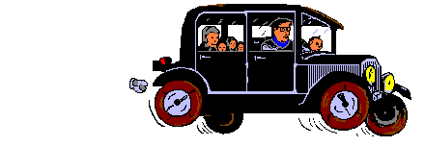
Discussion – Automobile Example
The brakes
do not
work!
Notes:
Which kind of problems can occur using a Smart Contract in this scenario?
Which ones would not occur if we were using a traditional contract?

